Slide 1
Unit 4 :
Performing simple queries
Session 3
Databases
1

Slide 2
The SELECT statement. Selection consultations
SELECT WITH LIKE
The LIKE clause is an operator that allows you to check whether a string of characters matches a pattern.
The syntax to use LIKE is:
LIKE 'pattern' expression
In the pattern, we write the characters that we want to match and, to represent any set of characters, the % wildcard is used and to represent that it is replaced by a single character, the _ wildcard is used .
2

Slide 3
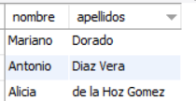
The SELECT statement. Selection consultations
SELECT WITH LIKE
Example: Obtain the first and last name of all customers whose first last name begins with the letter D.
SELECT firstname, lastname FROM customers WHERE lastname LIKE 'D%';
3

Slide 4

The SELECT statement. Selection consultations
SELECT WITH LIKE
Example 22: Obtain the license plate, make and model of all cars whose license plate ends with the letters NT.
SELECT license plate, make, model FROM automobiles WHERE license plate LIKE '%NT';
4

Slide 5
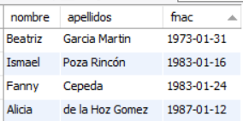
The SELECT statement. Selection consultations
SELECT WITH LIKE
Example: Obtain the first name, last name and date of birth of all clients born in January.
SELECT firstname, lastname,fnac FROM customers WHERE fnac LIKE '%-01-%';
5

Slide 6
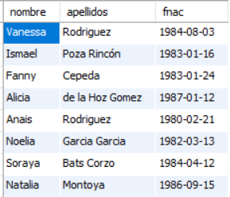
The SELECT statement. Selection consultations
SELECT WITH LIKE
Example: Obtain the name, surname and date of birth of all clients born in the 80s.
SELECT firstname, lastname,fnac FROM clients WHERE fnac LIKE '198%';
6

Slide 7

The SELECT statement. Selection consultations
SELECT WITH LIKE
Example : Obtain the license plate , make and model of everyone the automobiles whose second digit in the registration is a two and whose first letter on the registration it is J.
SELECT license plate, make, model FROM automobiles WHERE license plate LIKE '_2__J__';
7

Slide 8
The SELECT statement. Selection consultations
CHECK IF THERE IS NO VALUE LOADED IN A FIELD (CHECK IF A FIELD IS NULL).
When a field in a record or row in a board this empty is said to be null .
To check Yeah a expression ( usually a column ) is null , the syntax is used :
IS NULL expression
To check Yeah a expression is not null , it is that is , contains something , is used to syntax :
IS NOT NULL expression
8

Slide 9
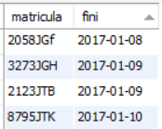
The SELECT statement. Selection consultations
CHECK IF THERE IS NO VALUE LOADED IN A FIELD (CHECK IF A FIELD IS NULL).
Example: Given that the contracts have the end date set to null when the contracts have not ended, obtain the license plate of the cars that are currently contracted and the start date of the contract .
SELECT enrollment,fini FROM contracts WHERE ffin IS NULL;
9

Slide 10
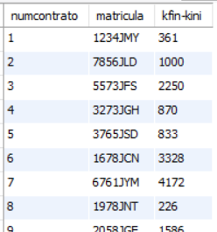
The SELECT statement. Selection consultations
CHECK IF THERE IS NO VALUE LOADED IN A FIELD (CHECK IF A FIELD IS NULL).
Example: Obtain the contract number, car registration number and kilometers traveled for all completed rental contracts.
SELECT contractnum,matricula,kfin-kini FROM contracts WHERE ffin IS NOT NULL;
10

Slide 11
The SELECT statement. Selection consultations
LOGICAL OPERATORS
We can make expressions composed of several conditions using logical operators.
Prevalence of logical and comparison operators:
comparison operators
NOT operator
AND operator
OR operator
Operator | Function
AND | Returns TRUE when both conditions are true
OR | Returns the value FALSE when both conditions are false
NOT | Returns the opposite of the condition following NOT
11

Slide 12

The SELECT statement. Selection consultations
LOGICAL OPERATORS
Example: Obtain the license plate, make, model and price of all cars with a rental price between €80 and €90.
SELECT license plate, make, model, price FROM cars WHERE price>=80 AND price <=90;
12

Slide 13
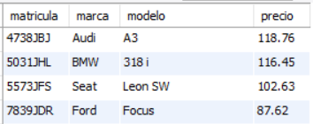
The SELECT statement. Selection consultations
LOGICAL OPERATORS
Example: Obtain the license plate, make, model and price of all cars with a rental price between €80 and €90 or between €100 and €120.
SELECT license plate, make, model, price FROM cars WHERE (price>=80 AND price <=90) OR (price>=100 AND price <=120);
13

Slide 14
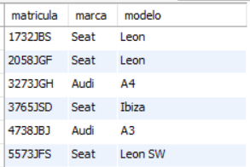
The SELECT statement. Selection consultations
LOGICAL OPERATORS
Example: Obtain the license plate, make and model of all SEAT, AUDI, HYUNDAI, TOYOTA brand automobiles.
SELECT license plate, make, model FROM automobiles WHERE make='seat' OR make='audi' OR make='hyundai' OR make='toyota';
14

Slide 15
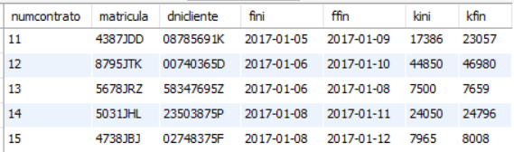
The SELECT statement. Selection consultations
LOGICAL OPERATORS
Example: Obtain all the data of the contracts started in 2017 and that have already ended.
SELECT * FROM contracts WHERE ffin IS NOT NULL AND fini LIKE '2017%';
15

Slide 16
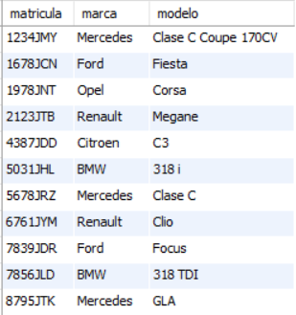
The SELECT statement. Selection consultations
LOGICAL OPERATORS
Example : Get all data on cars that are not SEAT or AUDI brands .
SELECT license plate, make, model FROM automobiles WHERE make !='seat' AND make !=' audi ';
SELECT license plate, make, model FROM cars WHERE NOT ( make ='seat' OR make =' audi ');
16

